Slide 1
File Management
A Developer's Guide to Windows 10 Andy & Jerry

Slide 2
File Management
Read/write files
Publisher folder
Data encryption
File Open/Save Pickers
Known Folders
Windows.Storage.AccessCache

Slide 3
Where are files?

Slide 4


Locations where apps can access data
Cloud
Credential Locker
App
App
File Open/Save Picker APIs
Picker Provider apps
Publishers Shared Folder
File System
B/ground Transfer
r/w
r/w
r/w
r/w
Temp
Pictures Videos Music
- Direct access needs manifest capabilities
App data Folders
Roaming
App data Folders
App
Known Folders
Local
r/w
App data Folders
r/w
App Package Folder
r/w
Removable
Storage (SD Card)
r/o

Slide 5





Package and App Data Folders
Package Manager installs all app files into the App package Folder
Read-only access from app
Apps store data in Local Folder
Settings and properties in the app settings dictionaries
Data in files
Structured data in database files
App Package Folder
Package Manager
Creates root folder
sandboxed to App
Install
DB
Files (r/o)
App Data Folder
App
Creates/Manages
files and settings
WinRT Storage APIs
Local or Roaming
Settings File
DB
Application
Files
Database file

Slide 6
Different Methods For Addressing Storage Locations
File Type/ API | Installation Folder | App data folder | Example
File access using Windows.Storage API via URIs | ms-appx:/// | ms-appdata:///local/ ms-appdata:///roaming/ ms-appdata:///temp/ | var file = await Windows.StorageFile.GetFileFromApplicationUriAsync( new Uri("ms-appdata:///local/AppConfig.xml"));
File access using Windows.Storage API via StorageFolder references | Windows. ApplicationModel.Package.Current. InstalledLocation | Windows.Storage. ApplicationData. Current .LocalFolder / .RoamingFolder / .TempFolder | var localFolder = Windows.Storage.ApplicationData.Current.LocalFolder; Windows.Storage.StorageFile storageFile = await localFolder.GetFileAsync("CaptainsLog.store");

Slide 7
Directly Accessible R/W Data Storage
Windows.Storage.ApplicationData
Windows.Security. Credentials
New
Roaming
Local
Temp
Publisher Cache
PasswordVault
Folder
Settings
Folder
Settings
Folder
Folder
Credentials
Other devices can access what you put in here
Data roamed cross-device
Limited to 100kb per application
Held in OneDrive storage
Store local data here for use by your application
Can store data up to the limit of the storage on the device
Retained if the application is updated
Use for temporary storage
No guarantee it will still be here next time your program runs
Cleaned up in a low storage condition
Shared storage for apps from same publisher
Declare in app manifest
Credential Locker
Use for secure storage of PasswordCred-ential objects
Data roamed cross-device

Slide 8
Basic Data Storage

Slide 9
Writing a complete file
This method will write text to a file
private async void writeTextToLocalStorageFile(string filename, string text) { StorageFolder fold = Windows.Storage.ApplicationData.Current.LocalFolder; StorageFile file = await fold.CreateFileAsync(filename, CreationCollisionOption.ReplaceExisting); await FileIO.WriteTextAsync(file, text); }
Sets the target folder
Sets action if file already exists

Slide 10
Reading a complete file
This method will read contents of a file into a string
private async Task<string> readTextFromLocalStorage(string filename) { var fold = Windows.Storage.ApplicationData.Current.LocalFolder; StorageFile file = await fold.GetFileAsync(filename); string result = await FileIO.ReadTextAsync(file); return result; }

Slide 11
Local Settings
Windows.Storage.ApplicationDataContainer localSettings = Windows.Storage.ApplicationData.Current.LocalSettings;
// Create a simple setting localSettings.Values["exampleSetting"] = "Hello Windows"; // Read data from a simple setting if (localSettings.ContainsKey("exampleSetting")) { // Access data in value string data = localSettings.Values[ "exampleSetting" ].ToString(); } // Delete a simple setting localSettings.Values.Remove("exampleSetting"); // Composite setting Windows.Storage.ApplicationDataCompositeValue composite = new Windows.Storage.ApplicationDataCompositeValue(); composite["intVal"] = 1; composite["strVal"] = "string"; localSettings.Values["exampleCompositeSetting"] = composite;

Slide 12
Roaming Settings and Roaming Folder
Roaming data enables an application to synchronise data and/or settings across different devices
Synced across all the users’ devices where the same app is installed
RoamingFolder and RoamingSettings are synced through the cloud
Limited to max 100KB for apps acquired from the consumer store

Slide 13
Credential Locker
Encrypted, roamed storage for PasswordCredential objects
void SaveCredential(string username, string password) { PasswordVault vault = new PasswordVault(); PasswordCredential cred = new PasswordCredential("MyAppResource", username, password); vault.Add(cred); } IReadOnlyList<PasswordCredential> RetrieveCredential(string resource) { PasswordVault vault = new PasswordVault(); return vault.FindAllByResource(resource); }
Learn More: See Module 1-12 Connected Experiences

Slide 14
File Handling

Slide 15
Apps from the same publisher may share files and settings

Slide 16
Publisher’s shared storage folder
A subfolder is required. Edit app manifest to add. Folders are automatically provisioned.
<Package> <Extensions>
<Extension Category="windows.publisherCacheFolder"> <PublisherCacheFolder> <Folder Name="Folder1"> </PublisherCacheFolder> </Extension>
</Extensions> </Package>

Slide 17
Shared storage folder interaction
Access folder named “fonts”
Windows.Storage.ApplicationData.Current .GetPublisherCacheFolder("fonts");
Clear shared storage
Windows.Storage.ApplicationData.Current .ClearPublisherCacheFolderAsync();

Slide 18
Known Folders

Slide 19
KnownFolders
KnownFolders is an API which simplifies the view the developer has of accessible user data on the phone
Rather than searching through all the possible different locations on the device for a particular type of file a program can request a single list of all the files
This includes files on the SD card (if inserted) along with files held on the device
Files in KnownFolders are visible to all apps (that have registered the proper capabilities)
Consider using the FileOpenPicker API as an alternative to allow users to select a file in these folders
No capabilities required as consent is implied

Slide 20
KnownFolders
Physical View
Logical View
Internal storage
KnownFolders.PicturesLibrary. GetFilesAsync()
C:\Users\Public\Pictures\Seattle\
C:\Users\Public\Pictures\Birthday\
StorageFile: Pic01.jpg
C:\Users\Public\Pictures\Pic01.jpg
StorageFile: Pic01.jpg
StorageFile: Pic02.jpg
SD Card (if present)
D:\Pictures\Portland\
D:\Pictures\Birthday\
D:\Pictures\Pic01.jpg
D:\Pictures\Pic02.jpg
D:\Pictures\Hawaii\Pic02.jpg

Slide 21
Accessing User Content
var pictures = await Windows.Storage.KnownFolders.PicturesLibrary.GetFilesAsync();
KnownFolders provides access to:
Pictures
Videos
Music

Slide 22
KnownFolders allows direct access to user content folders (but don’t forget to declare the Capabilities)

Slide 23
File Open/Save Pickers

Slide 24
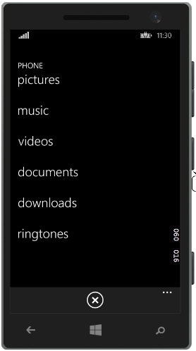
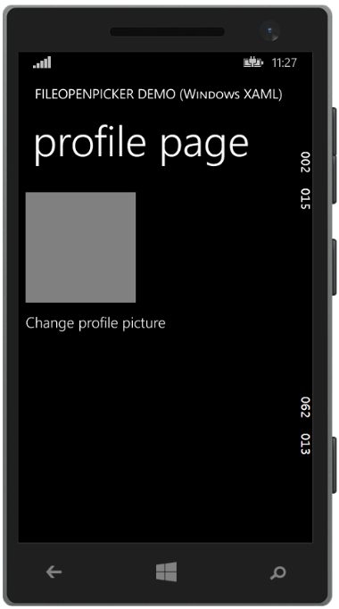
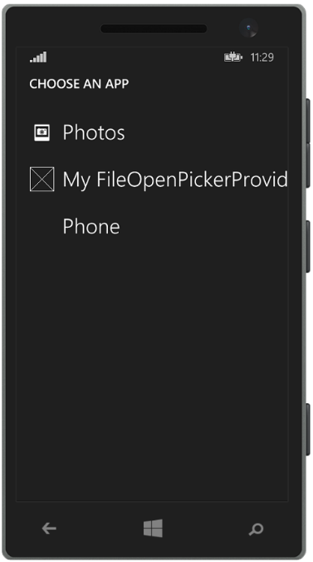
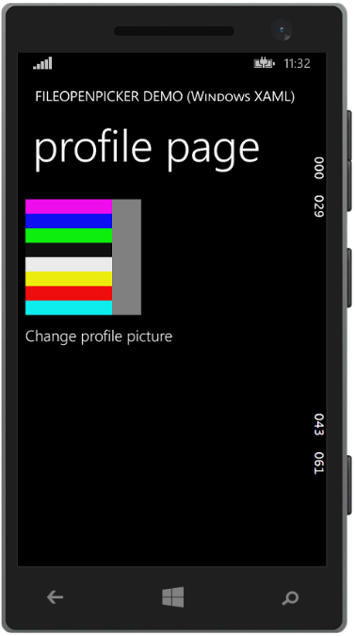
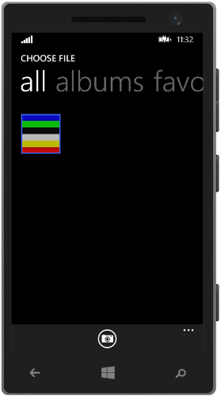

FileOpenPicker/FileSavePicker UX
Other apps…
Your app
Provider selection (shell)
Provider UI
Your app

Slide 25
Picker Goals
Apps shouldn’t care where files come from or go to
Apps can access any type of file
Allows an app to access files that are not in the app data folders
Access files in Pictures Library, Videos Library without using KnownFolders API (needs Capability declaration) – permission is implied since the user selects the file
Seamlessly go out to the cloud, device or an app to get a file
Support both Open and Save
Save to the cloud, device or an app
Update latest changes as required (handled by the provider)

Slide 26
Pick a File
//Create the picker object FileOpenPicker openPicker = new FileOpenPicker(); openPicker.ViewMode = PickerViewMode.Thumbnail; openPicker.SuggestedStartLocation = PickerLocationId.PicturesLibrary; // Users expect to have a filtered view of their folders openPicker.FileTypeFilter.Add(".jpg"); openPicker.FileTypeFilter.Add(".png"); // Open the picker for the user to pick a file StorageFile file = await openPicker.PickSingleFileAsync(); if (file != null) { // Do something with the file... }
Note: The Windows Phone 8.1 PickSingleFileAndContinue() API has been deprecated (Yay!)

Slide 27
Save a File
//Create the picker object FileSavePicker savePicker = new FileSavePicker(); savePicker.SuggestedStartLocation = PickerLocationId.DocumentsLibrary; // Dropdown of file types the user can save the file as savePicker.FileTypeChoices.Add("Plain Text", new List<string>() { ".txt" }); // Default file name if the user does not type one in or select a file to replace savePicker.SuggestedFileName = "New Document"; // Open the picker for the user to select the target file StorageFile file = await openPicker.PickSaveFileAsync(); // Save the content to the file ...

Slide 28
Using the File Open/Save pickers
demo

Slide 29
File Picker Provider apps
You can create Picker Provider apps
Listed in the shell Picker UI that the user can select
Allows user to pick files that the provider app controls, or to save new files in the storage of that provider
Example: OneDrive app is a picker provider that allows users to pick and save files in their OneDrive account in the cloud
See MSDN documentation for further details

Slide 30
File Pickers allow file access to user folders and to locations served by File Picker Provider apps

Slide 31
AccessCache

Slide 32
What is AccessCache?
Imagine an app that uses the File pickers to open and save files at any location
What if the user wants to reopen a file he or she edited last week?
Do we need to show the picker and get the user to open the file again?
We need a way to store references to files and folders and their permissions so that the user can reopen them with one tap
That way is through Windows.Storage.AccessCache.StorageApplicationPermissions

Slide 33
FutureAccessList and MostRecentlyUsedList
All apps have a FutureAccessList and a MostRecentlyUsedList (MRU)
The MRU is a list you can use to track the files and folders your user accesses frequently
25-item limit, automatically managed so oldest item automatically removed when limit is reached
FutureAccessList is a list you can use to store files and/or locations (like folders) and easily access them in the future
1000-item limit, but not automatically managed, so you must remove items when limit is reached
If File or Folder is later moved, FutureAccessList tracks it automatically, maintaining access in the future
When a user picks a file or folder, you should consider adding that item to both the MRU and the FutureAccessList

Slide 34
Usage – Saving in the AccessCache
// Open the picker for the user to pick a file StorageFile file = await openPicker.PickSingleFileAsync(); if (file != null) { // Save the picked file in the AccessCache // Add to MRU with metadata (For example, a string that represents the date) string mruToken = StorageApplicationPermissions.MostRecentlyUsedList.Add(file, "20120716"); // Add to FA without metadata string faToken = StorageApplicationPermissions.FutureAccessList.Add(file); } else { // The file picker was dismissed with no file selected to save }

Slide 35
Retrieving from the Access Cache
// get the token for the first item in our MRU // use it to retrieve a StorageFile for that file String mruFirstToken = StorageApplicationPermissions.MostRecentlyUsedList.Entries.First().Token; StorageFile retrievedFile = await StorageApplicationPermissions.MostRecentlyUsedList.GetFileAsync(mruFirstToken); ... // Retrieve tokens for all items in the MRU AccessListEntryView mruEntries = StorageApplicationPermissions.MostRecentlyUsedList.Entries; if (mruEntries.Count > 0) { foreach (AccessListEntry entry in mruEntries) { String mruToken = entry.Token; // Continue processing the MRU entry ... } }

Slide 36
File Management
Read/write files
Publisher folder
Data encryption
File Open/Save Pickers
Known Folders
Windows.Storage.AccessCache

